Slide 1
Time-Varying Ankle Mechanical Impedance During Human Locomotion
ENPM640 Rehabilitation Robotics - Final Project
Yashas Shetty - 119376348
Sameer Arjun S - 119385876

Slide 2
Contributions
Yashas Shetty:
Research on topic and methodology implementation
Performed mathematical calculations replicating all the equations in Matlab to implement the paper
Report consolidation and presentation work
Sameer Arjun S:
Research on topic and literature survey
Worked on data-set extraction and implemented of Matlab functions
Presentation work and report consolidation

Slide 3
Literature Survey
M. Lortie and R. E. Kearney, “Identification of physiological systems: Estimation of linear time-varying dynamics with non-white inputs and noisy outputs” This paper presents a correlation-based least-squares approach for identifying linear time-varying systems from ensembles of input-output realizations. This is compared to a previously proposed least-squares technique and provides more reliable estimates of the dynamics.
. J. Rouse, L. J. Hargrove, E. J. Perreault, and T. A. Kuiken, “Estimation of human ankle impedance during walking using the perturberator robot” The impedance of the ankle was estimated using a second-order parametric model, and the variance accounted for (VAF) was used to quantify the agreement of the model with the experimental results.
H. Lee, “Quantitative characterization of multi-variable human ankle mechanical impedance,” PhD Thesis, Mechanical Engineering 2013, MIT
This the PhD thesis of the author, which was used as reference for our work

Slide 4
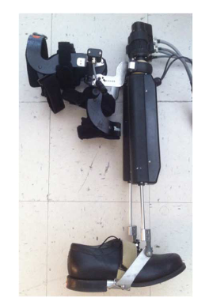
Rationale for selecting the article
The ankle joint plays a crucial role in various aspects of human movement, particularly during locomotion and understanding how ankle impedance changes due to injuries or neurological conditions can guide therapists in developing more effective rehabilitation programs
Furthermore, this paper is the first to factor in inversion-eversion along with dorsiflexion-plantarflexion to estimate the ankle impedance required for a rehabilitation system using the anklebot.

Slide 5
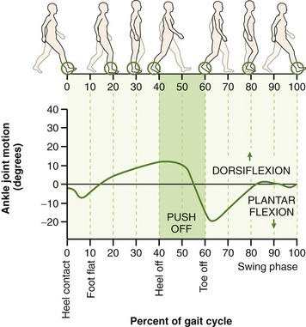
Objective
This paper is aimed to characterize the time-varying mechanical impedance of the human ankle during different subphases of walking, including heel-strike and toe-off, and to examine the ankle's behavior in both the sagittal and frontal planes.
The study also aims to provide insights into the time-varying nature of ankle impedance, which has implications for understanding human locomotion and for the design of rehabilitation interventions and assistive devices.

Slide 6
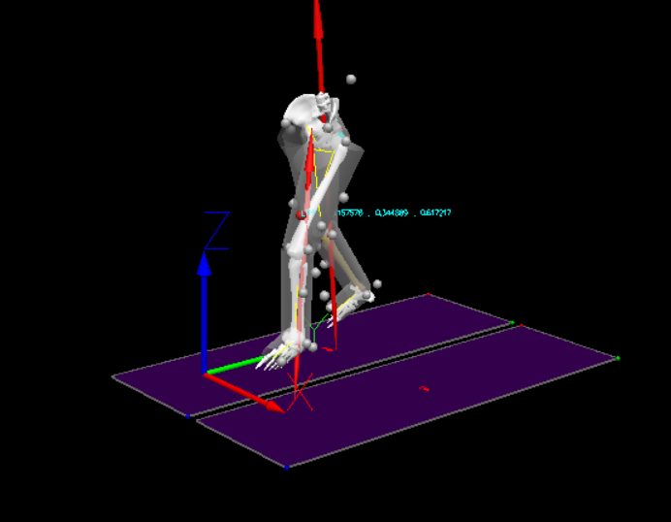
Methodologies
This paper uses the Anklebot for identifying time-varying ankle impedance in 2 degrees of freedom (DOFs) during walking on a treadmill to record the angular displacements and torques at the ankle in joint coordinates
A modified linear time-varying (LTV) ensemble-based system identification method was implemented to estimate the ankle mechanical impedance
The time-varying ankle mechanical impedance was approximated by a second-order model consisting of inertia, viscosity, and stiffness in both inversion-eversion and dorsi-plantar flexion directions

Slide 7





Methodologies - Explanation
The model takes measured torque inputs (u) from the anklebot and outputs (z) the ankle’s angular displacement along with appropriate values of inertia, viscosity and stiffness.
Where, h(i,j) is the Impulse Response Function and delta(t) is the time interval
Is the input-output correlation function estimate & is the input auto correlation function. From this, the IRF estimate can be calculated by:

Slide 8
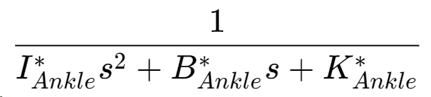
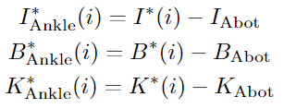
Methodologies - Explanation
The IRF estimate obtained in the previous step is approximated as second order differential to obtain the inertia (I), viscosity (B) and stiffness (K) values using the fminsearch function:
The optimal parameters of I, B, K are obtained by compensating for the anklebot dynamics in ankle joint coordinates:+
h is approximated as

Slide 9
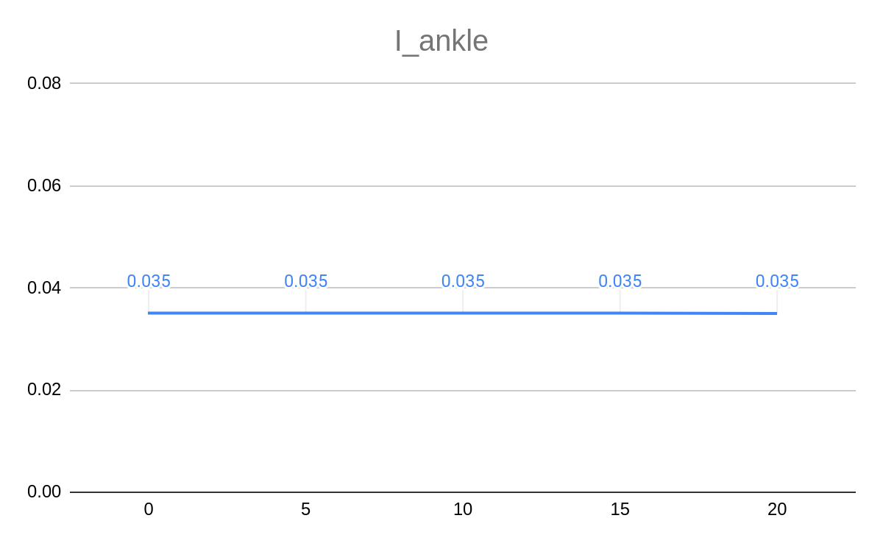
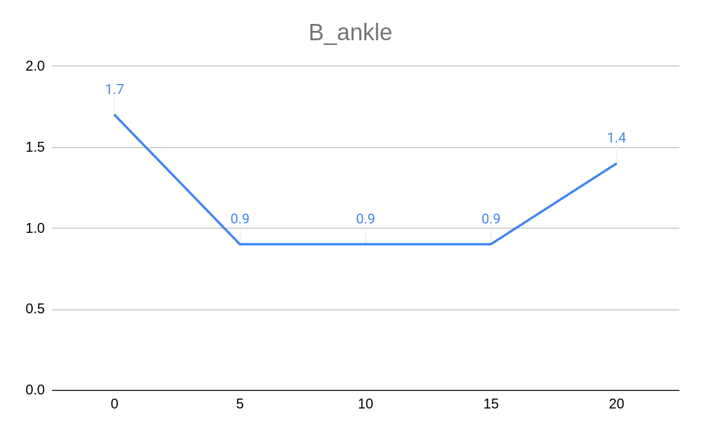
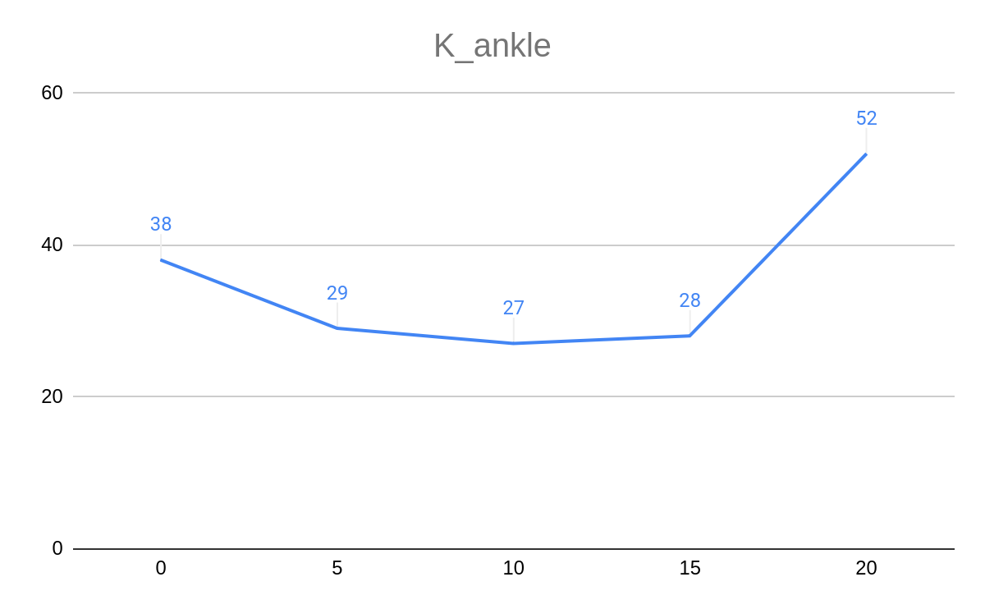
Deliverables/Results
We used actual measurements from and obtained the following plots for I, B, K
As we can see, the obtained dynamics are close to the ankle bot dynamics, we were able to conclude that anklebot dynamics are significant in the ankle mechanical impedance

Slide 10
Conclusions
This study provides a comprehensive characterization of time-varying ankle mechanical impedance during human locomotion, which helps for ankle impedance modulation during walking.
The findings highlight the importance of considering ankle impedance in multiple degrees of freedom and across different subphases of the gait cycle.
We were able to confirm that ankle bot dynamics are significant as compared to the ankle dynamics.

Slide 11
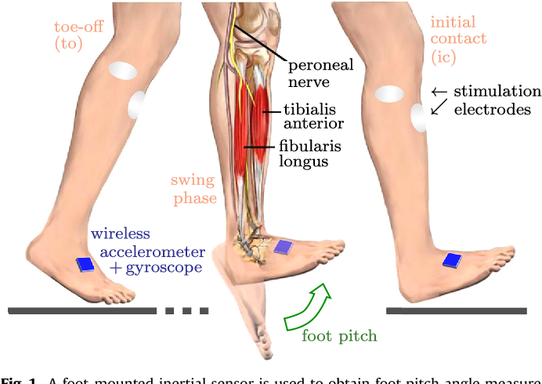
Future Work
Investigation of the paretic ankle during walking will add unique and invaluable information to existing quantitative measures and ultimately enable better design of rehabilitation protocols to improve patients' functional motor skills.

Slide 12
Thank You

